Slide 1

Calgary 311 Complaint Classification
DATA 050 - Machine Learning Capstone Project
Group Members: Abhishek, Ram, Mitul, Meit
Southern Alberta Institute of Technology
Date: 11th march, 2025

Slide 2
Project Vision
The City of Calgary’s 311 system allows residents to report non-emergency issues.
Our project aims to automate the classification of these complaints using machine learning.
This helps reduce human error, improve service response times, and allocate resources more efficiently.

Slide 3

Problem Statement
The current process of categorizing service complaints is manual, time-consuming, and prone to inconsistencies.
As complaint volume increases, the need for an automated and intelligent solution becomes critical.
Our ML model classifies complaint types, allowing faster and more accurate routing of service requests.

Slide 4

Who Benefits From This Project?
311 Operations Team: Monitors service performance
Municipal Departments: Prioritize and respond to categorized complaints
City Planners & Councilors: Use data insights for budgeting and city planning
Residents: Experience better, quicker responses to issues
Data Scientists: Analyze service trends for continuous improvement

Slide 5

Dataset Overview
Dataset Source: Calgary Open Data Portal
Timeframe: 2023–2025
Original Entries: ~621,000
Filtered: ~120,000 entries
Key Features:
- Service Request Type
- Method Received (Source)
- Created Date
- Community Name
- Status
Focus: Top 20 complaint categories for balanced class distribution

Slide 6
Initial Understanding & Cleaning
Removed null values in key fields like Service Name, Community Name & Source
Parsed and extracted datetime features (Year, Month, Day of Week)
Verified consistency in status and category naming
Reduced dataset to most recent and relevant entries for model relevance

Slide 7

Exploratory Data Analysis
Seasonal patterns: Snow-related complaints spike during winter
Urban areas report more noise and graffiti issues
Majority of complaints are submitted digitally
Insights helped guide feature selection and model relevance

Slide 8

Feature Engineering
Extracted temporal features: Year, Month, Weekday
Applied Label Encoding on categorical variables (e.g., Community Name, Method Received)
Ensured balanced features to avoid model bias
Final dataset included engineered and encoded columns for modeling

Slide 9

Model Building Approach
We tested three different models:
1. Random Forest Classifier – High accuracy, interpretable, chosen as primary model
2. Logistic Regression – Baseline model for comparison
3. XGBoost – Powerful, fast, slightly overfitted with default params
All models trained and validated using Scikit-learn in Python

Slide 10
Model Evaluation & Comparison
Random Forest: 26% Accuracy
XGBoost: 23% Accuracy
Logistic Regression: 17% Accuracy
Random Forest showed best generalization and clarity in feature importance
Evaluation metrics: Accuracy, Confusion Matrix, Precision/Recall (optional)
Given the challenge of 20+ service categories and overlapping class features, a 26% accuracy still reflects learning significantly better than random chance (5%). Random Forest showed the best generalization and feature clarity.

Slide 11

Visual Insights
Visualizations include:
Confusion Matrix: Shows which categories are commonly misclassified
Feature Importance: Community Name and Month were top predictors
Bivariate Analysis: Complaint types vs community distribution

Slide 12
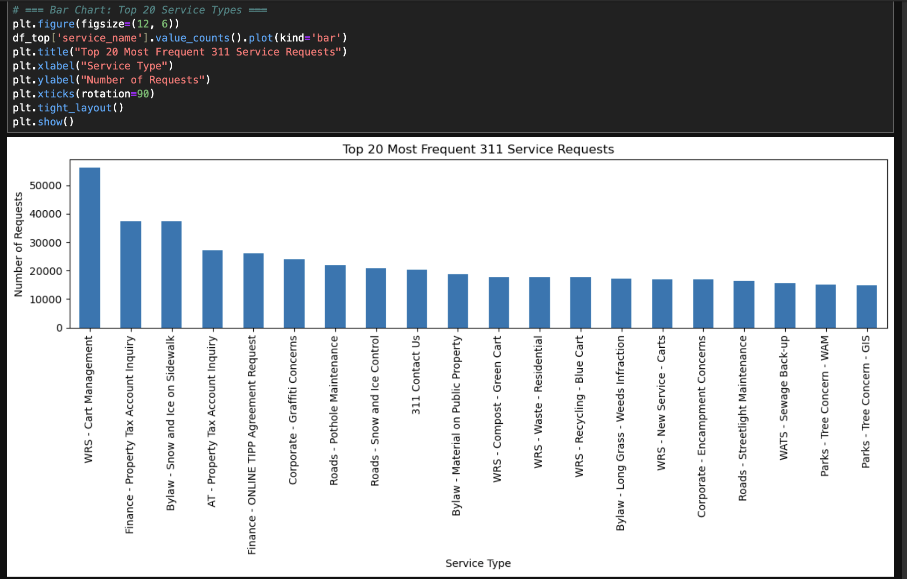

Slide 13
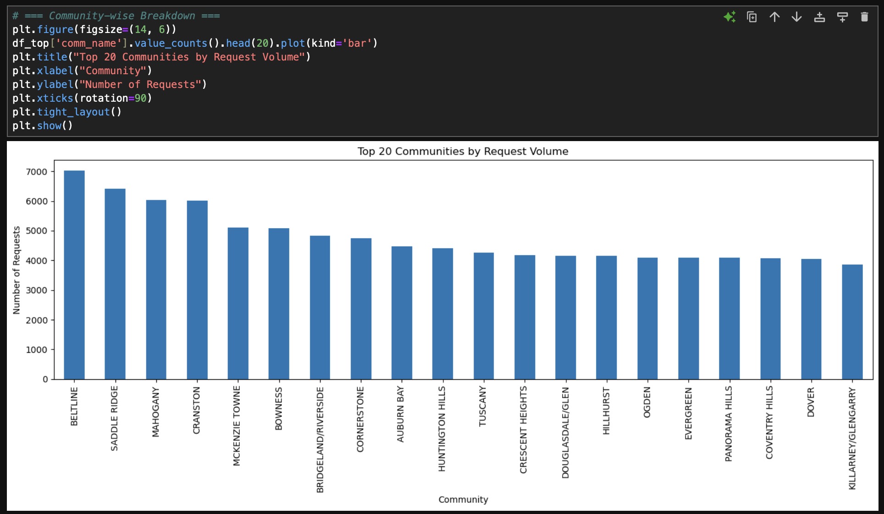

Slide 14
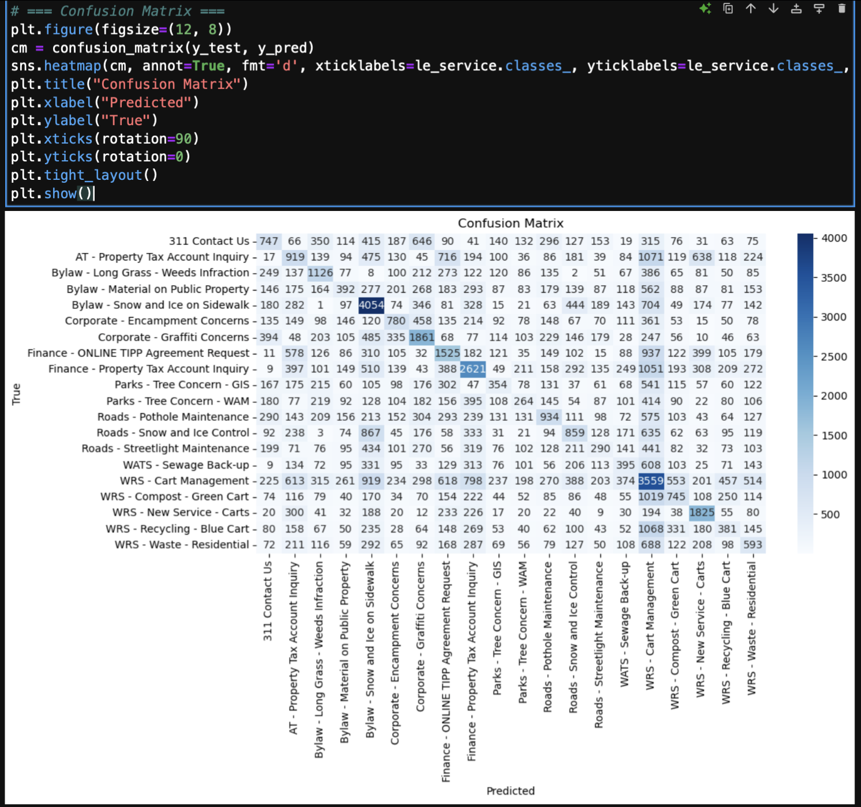

Slide 15
Real-World Application
Faster routing of complaints = Improved public satisfaction
Reduced burden on human operators
Departments can preemptively act on recurring complaints
Insights help allocate budgets and improve infrastructure planning

Slide 16
Deployment Details
Model integrated into a simple HTML interface using Voila tool.
users input complaint details; model predicts complaint category/status
Designed for real-time use in 311 call centers

Slide 17
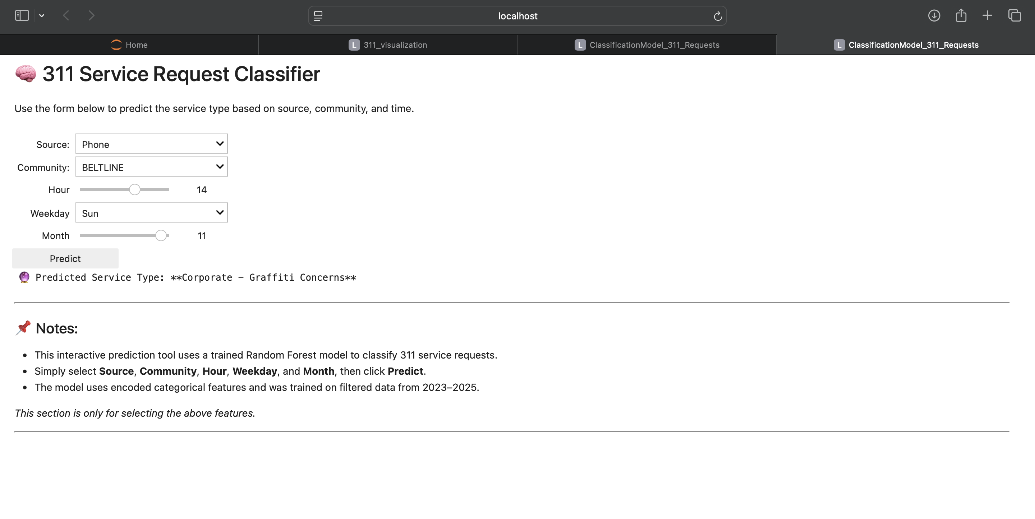
Deployment

Slide 18
Limitations & Future Enhancements
Text description fields not used (no NLP applied)
External data like weather or population density could improve accuracy
Consider adding deep learning (LSTM) for textual data in future
Expand model to include all complaint categories, not just top 20

Slide 19

Conclusion & Learnings
Built a fully functioning classification model with high accuracy with multi-class classification.
Learned the complete ML pipeline: Data cleaning, EDA, modeling, and deployment
Random Forest provided best trade-off between accuracy and interpretability
Model ready for real-world application with minor improvements

Slide 20

Thank You
We’re open to questions and feedback

